Slide 1

AGRICULTURE 4.0

Slide 2
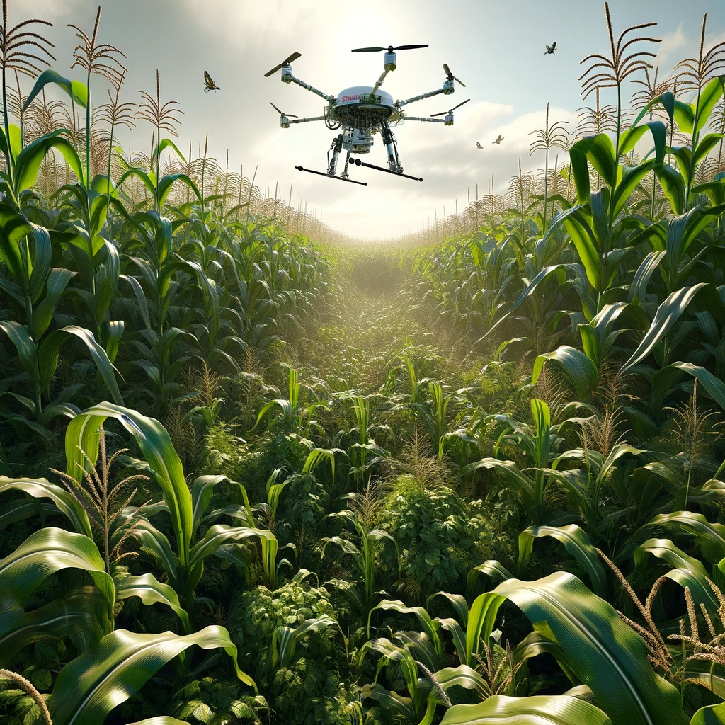

Introducing Agrobots
Agrobots envisions a new paradigm for agriculture—one where we produce and deliver food in a cleaner, more efficient way, using modular robotics and advanced AI to nurture the land instead of depleting it.
Our unified terrain management platform, Land OS, powers a complete service that makes land sustainably productive—delivering fresher, greener, and more profitable outputs for all stakeholders.

Slide 3
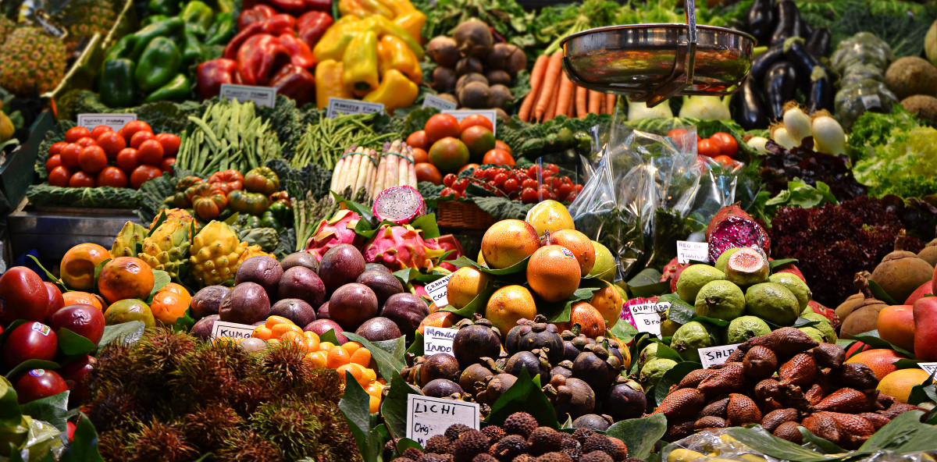
Challenges of 21st century agriculture
To secure the future, agriculture must pursue these objectives:
Increase Food Security Today, more food is generated than our current population requires, yet it fails to reach many who need it most. Thousands of tons go to waste after being transported across vast distances. By producing what is consumed locally at each site—using AI and expert guidance to create robust, proactive farms—we can make food supplies more reliable and more equitable.
Reduce Ecological Impact A growing population, coupled with rising standards of living, demands more resources than the current industrial paradigm can sustain without long-term damage to our biosphere. Fertile soil erodes, water tables decline, and chemical inputs pollute rivers and aquifers. We need methods that cut resource use and preserve ecosystems.
Adopt an Integrative Paradigm In conventional agriculture, living organisms are viewed primarily as market products, rather than vital players in a shared environment. We envision a new approach in which crops, livestock, and microorganisms interact naturally in healthy, well-designed habitats. By recognizing each species’ inherent role, we can raise food in settings that foster both abundance and ecological balance.

Slide 4
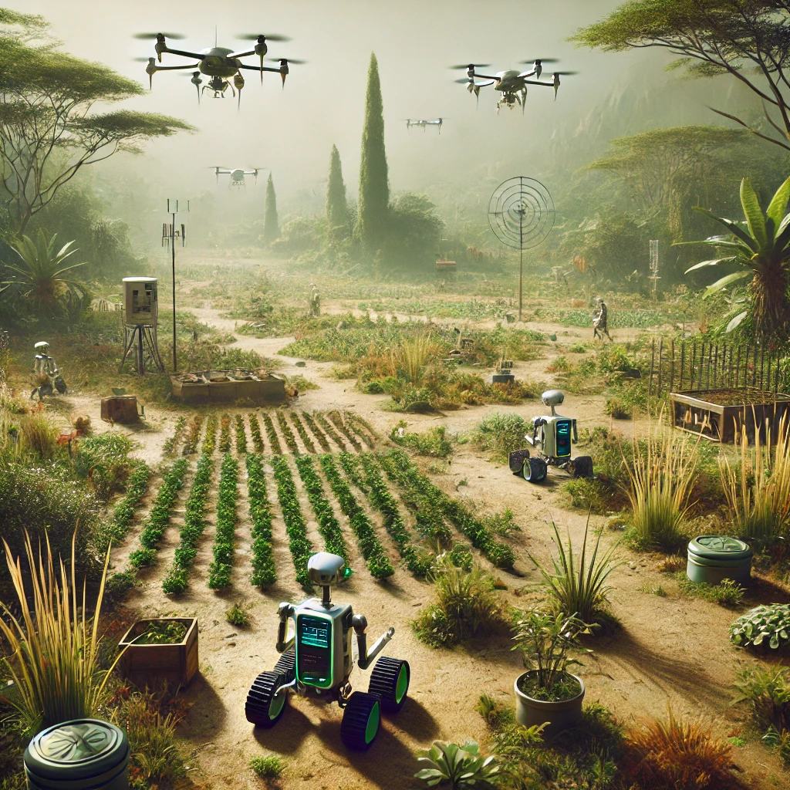
Bioromes
Bio-Robotic Modular Ecosystems
A biorome combines nature’s inherent diversity with modern data intelligence. Instead of pushing single crops through massive machinery, we deploy multiple simple robotic modules that each perform a single task—seeding, harvesting, transport, or monitoring.
Land OS coordinates these modules using real-time sensor data and predictive AI, designing and managing a living system that continuously adapts to local conditions. Within each biorome, plants, animals, and microbes are carefully balanced—so chemical inputs drop dramatically, and the land becomes self-optimizing.

Slide 5


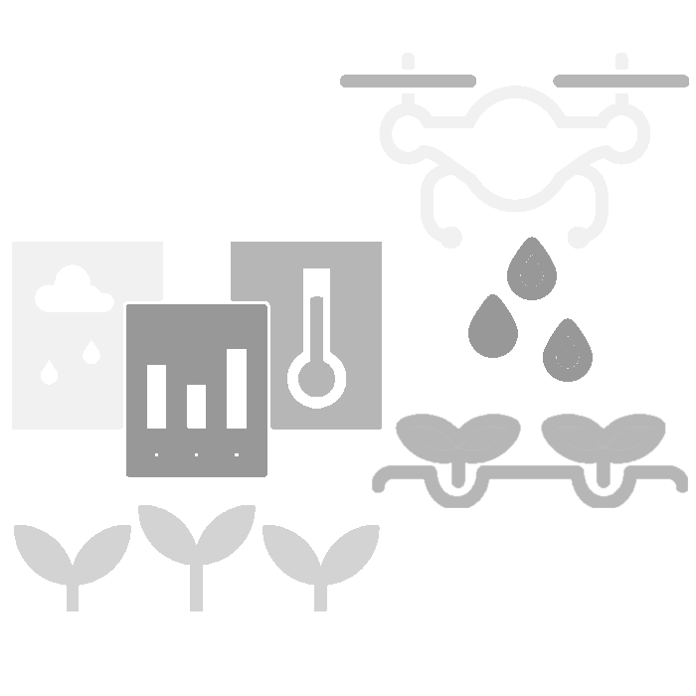
How to bioromize a terrain
1. Design
Our expert Ecosystem Engineers study the terrain and use our powerful Artificial Intelligence platform to design the perfect productive ecosystem for the farm's plants and animals.
2. Implementation
We progressively add robotic modules to the land to monitor and transform it, at the same time improving the knowledge of Artificial Intelligence and the interactions between the different living beings of the productive ecosystem.
3. Operation
Once established, the biorome runs autonomously, guided by our remote operations center. Plants and animals receive precisely what they need, when they need it, and the system can scale or adapt without major disruptions.

Slide 6
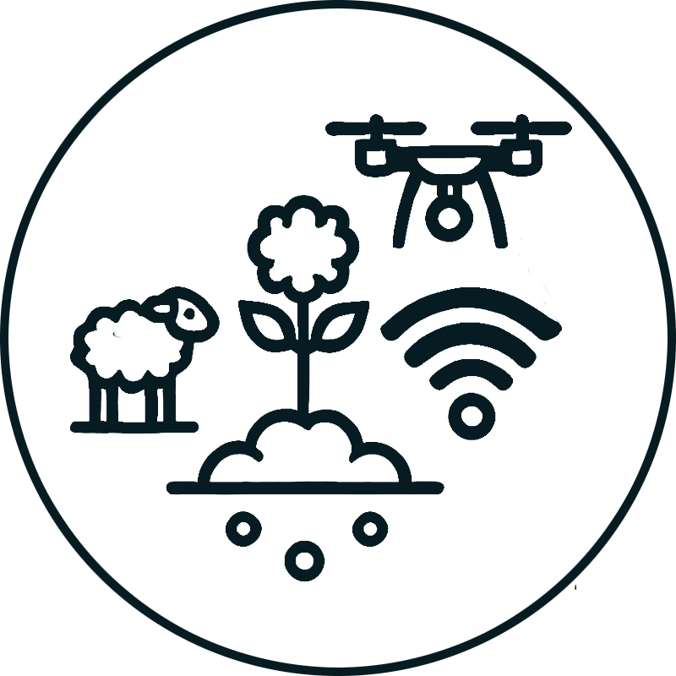



The Evolution of Agriculture
4.0
AI Powered
Agriculture has evolved from manual labor to data-driven, automated systems. Bioromes represent the next step—self-sustaining, intelligent farming environments designed to maximize efficiency, minimize waste, and create resilient food systems for the future.
3.0
Diesel
Powered
AI-driven farming optimizes land use with real-time monitoring, predictive analytics, and automated robotic systems. By integrating IoT, machine learning, and precision agriculture, food can be grown closer to demand, reducing waste and ecological impact.
2.0
Animal
Powered
1.0
Human Powered
The Industrial Revolution introduced mechanized farming with tractors and industrial machinery, dramatically increasing output. Large-scale monocultures, fertilizers, and irrigation systems shaped modern agribusiness but at an environmental cost.
The domestication of animals revolutionized farming by introducing the plow, increasing efficiency, and allowing for larger-scale cultivation. This shift supported population growth and the expansion of civilizations.
For most of human history, farming was done by hand with simple tools. Productivity was low, and survival depended on labor-intensive work, making agriculture a slow and inefficient process.
12.000 years ago
5.800 years ago
120 years ago
Today

Slide 7
Optimization Engine (AI)
Analyzes all interactions within the biorome and builds a predictive model to optimize operations. It continuously refines its model based on new data and generates precise parameters for efficient management.
Publishes operational parameters for automated field execution.
Operations Engine (IoT Control)
Executes field operations by managing robotic modules and implementing the AI’s parameters. It ensures real-time adaptation to maintain optimal conditions for plants and animals.
Land OS
The three core systems
Delivers real-world data, expert inputs, and external factors to refine decision-making.
Reports system status and field conditions to continuously improve models.
Analytics Engine (Hybrid Data Layer)
Aggregates and normalizes data from biorome sensors, external sources (market, weather, regulations), and ecosystem engineers' inputs. This enriched dataset improves the AI’s predictions and operational planning.

Slide 8
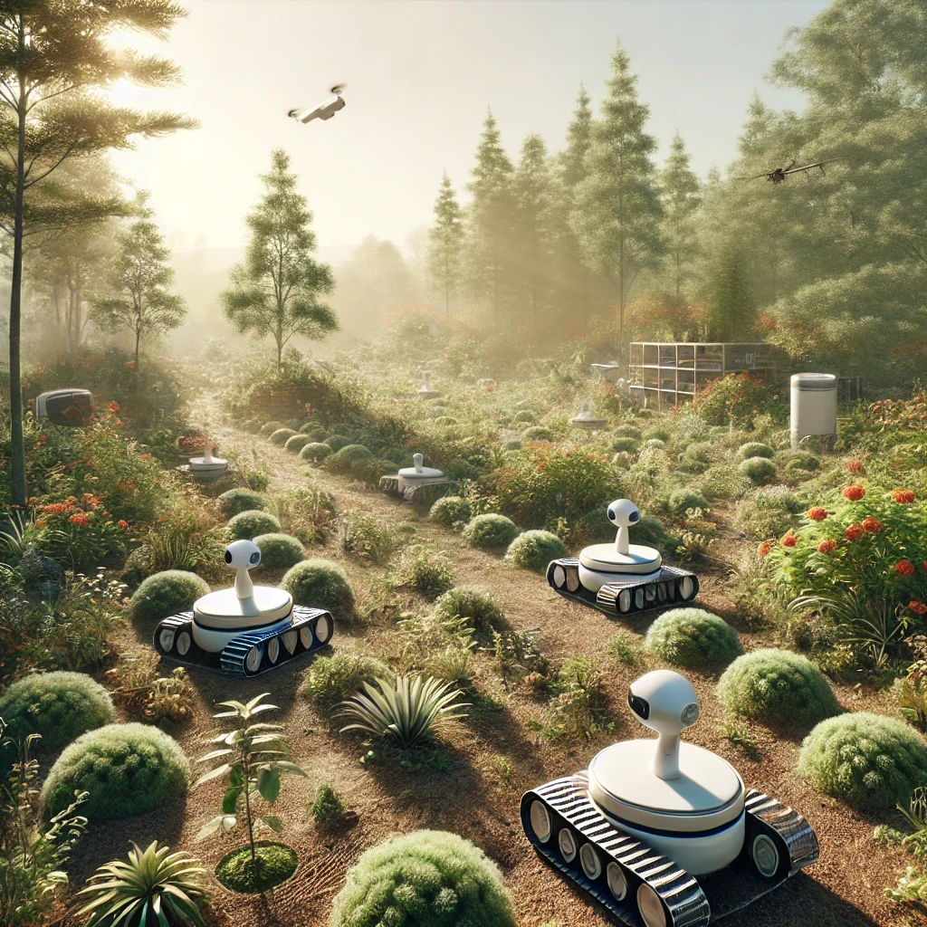
A day in a biorome
The first light filters through the canopy, illuminating a landscape that seems untouched, except for the near-invisible presence of technology. Birds begin their morning calls, small animals stir, and the air is thick with the scent of damp earth and growing plants.
Hidden in the undergrowth, sensors begin their daily reports, registering moisture levels, soil composition, and plant health. Drones lift off from their charging stations, scanning the terrain with quiet precision. A patch of crops has absorbed more water than expected overnight—no need for irrigation in that sector. Meanwhile, a robotic module adjusts a water valve nearby, redirecting resources to drier zones.
Deep in the vegetation, a monitoring unit detects an animal behaving unusually. The system flags it, analyzing past movement patterns to determine if intervention is needed. A drone glides overhead, zooming in to confirm—one hen shows signs of illness. The data flows seamlessly into the Optimization Engine’s model, which recommends isolating the bird. A simple adjustment to the feed dispenser ensures the affected animal receives a tailored treatment, without disrupting the entire ecosystem.
At midday, a light rain rolls in, anticipated hours before by the system. No need to activate irrigation. A feeding module dispenses a carefully balanced mix for the livestock, based on real-time nutritional tracking. The land adapts fluidly, responding to the needs of plants, animals, and microbes alike, without human intervention.

Slide 9
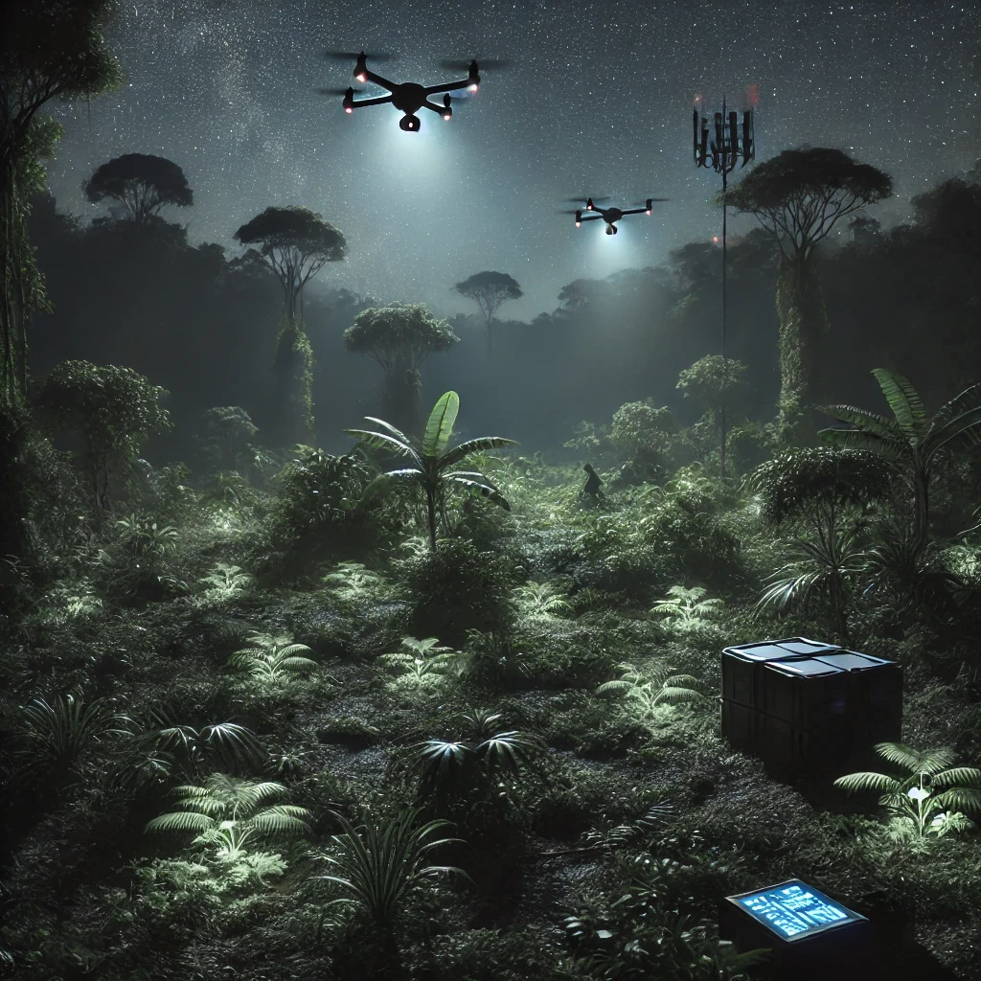
A night in a biorome
As dusk settles, the biorome transitions into night mode. The last rays of sunlight fade, but the system remains fully operational. Nocturnal pollinators emerge, guided by natural patterns rather than artificial interference. The temperature drops, and the Optimization Engine updates its models in real time, adjusting growth strategies for the coming day.
This is the ideal time for certain tasks. Cooler air reduces plant stress, making it the perfect window for precision irrigation. Water is directed exactly where it’s needed, minimizing evaporation. Some robotic modules move to apply slow-release nutrients where Land OS has detected deficiencies, ensuring optimal absorption by morning. Others handle delicate harvesting operations—some crops are best collected under the dew-laden air to retain freshness.
A slow-moving drone glides silently through the canopy, performing infrared scans to ensure all monitored species are where they should be. Its faint red navigation lights flicker momentarily against the foliage. Nearby, a small rodent disturbs a patch of soil, prompting the sensors to log the micro-disturbance, an indicator of healthy underground biodiversity.
A soft hum of activity persists: water is redirected, micro-adjustments are made, and a few robotic modules shift position for their next task. By dawn, the cycle begins anew—seamlessly adjusting, growing, and optimizing, without ever disrupting the balance of the land.

Slide 10

Revenue & Monetization - Market
Our business is terrain management—not food sales, not equipment sales, not software licenses.
Through Land OS, we deliver Terrain Management as a Service (TMaaS) to landowners, institutions, and regions. We turn underutilized or degraded land into regenerative ecosystems, and operate them continuously to ensure productive, ecological performance.
Each deployment is managed autonomously through Land OS and generates recurring revenue through service contracts, ecosystem optimization fees, and performance-based incentives—such as yield improvements, carbon offsets, biodiversity gains, and water savings.
Bioromes are designed for high-efficiency production, allowing us to optimize margins while reducing waste and logistics costs. Our just-in-time and just-in-place model removes expensive intermediaries, keeping food fresher and transportation costs lower.
Performance-Aligned Fixed Pricing
Each terrain under management is configured around the KPIs that matter most to the client—whether that’s productivity, soil regeneration, water efficiency, biodiversity gains, carbon offsets, or yield resilience. These indicators help measure progress and guide continuous improvement, without affecting the fixed pricing structure.
Our model aligns incentives through transparent impact tracking and long-term partnership logic. Land OS continuously optimizes terrain performance, delivering ecological and economic value at scale—without requiring clients to invest in robotics, infrastructure, or software.

Slide 11
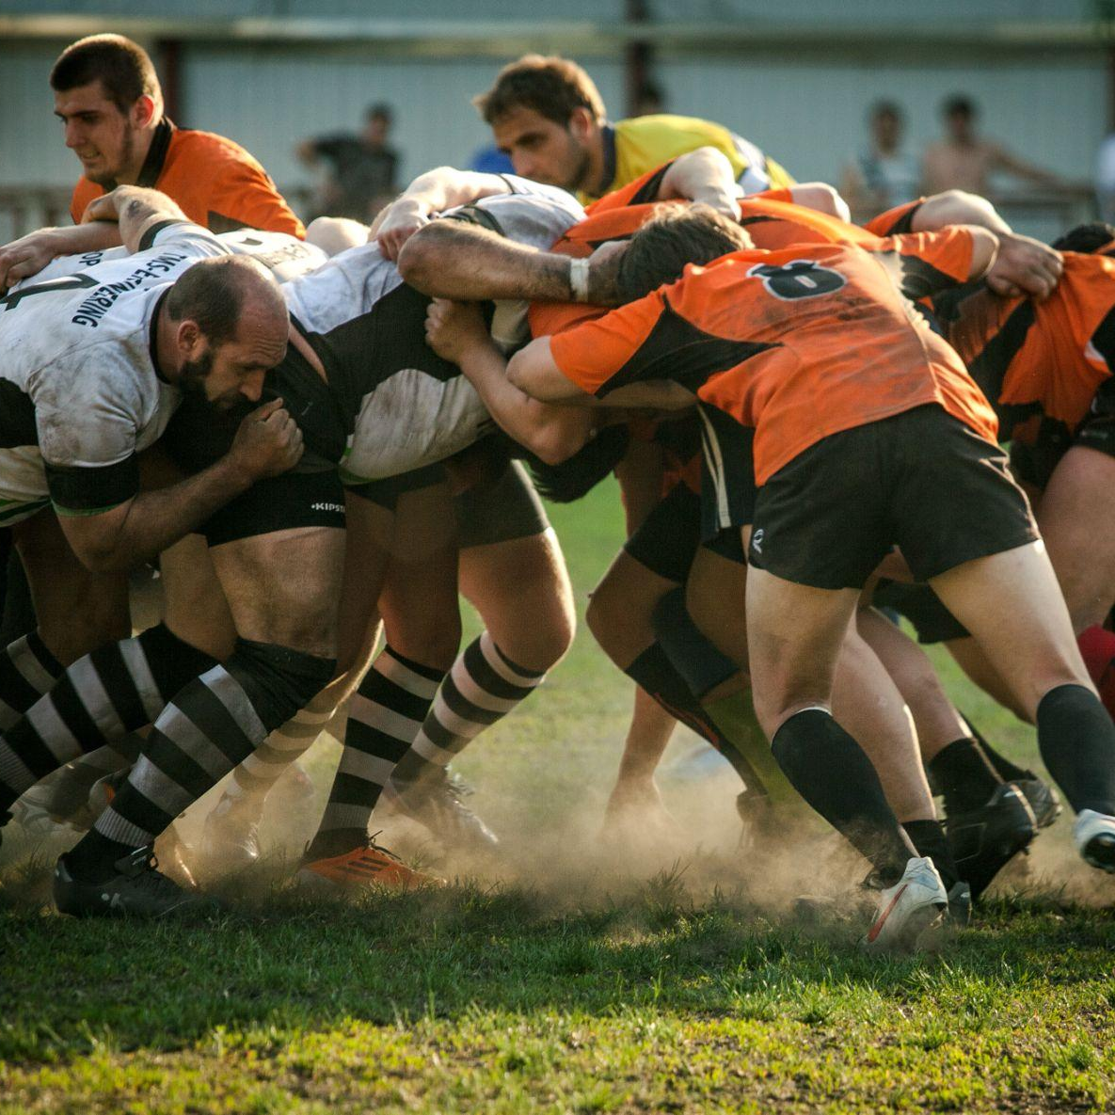
Road to Success - Partners
ACES Consortium
Agrobots leads the ACES Consortium, an alliance of OEM partners developing a universal standard for modular robotics in agriculture. The goal is simple: make drones, sensors, robotic parts, charging stations, etc. from different manufacturers work together seamlessly.
ACES defines a shared “plug and play” language so equipment can connect instantly and operate under our LandOS platform. This open, royalty-free standard reduces costs, speeds up deployment, and positions Agrobots at the center of a fast-growing ecosystem. The first draft of the protocol is complete, and our partners are already adapting their equipment for ACES certification and upcoming pilot deployments.
Production Projects
We are joining forces with industry and academic partners, including members of the ACES Consortium, to compete in major international tenders. Current proposals include an agricultural waste recycling program in Mexico and a climate-resilience initiative in Fiji to help farmers adapt to sea-level rise and soil salinization. These collaborations expand Agrobots’ reach and demonstrate the global relevance of our technology.

Slide 12
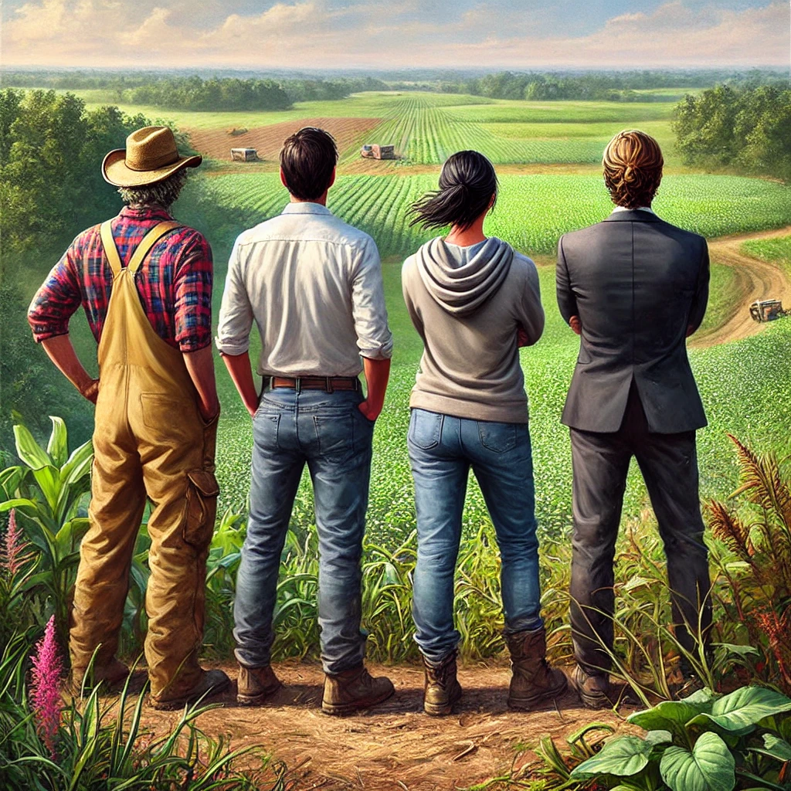
Revenue & Monetization - Customers
Our Customers
Land OS serves a range of terrain owners and stewards through a flexible service model.
Agri-Cooperatives & Estates – Large landholding entities that seek efficiency, ecological certification, or long-term viability through automation and AI.
Private Landowners – Individuals with idle, contaminated or underperforming land who want it to become productive without hands-on management.
Public Institutions – Municipalities, local agencies, or conservation authorities aiming to regenerate land or meet climate targets. Identified vertical for future expansion.
Each customer type benefits from a different Land OS configuration, whether focused on yield, regeneration, or ecosystem services.

Slide 13

Revenue & Monetization - Growth Model
Land OS is designed to scale through intelligent architecture and strategic partnerships.
No hardware manufacturing – We integrate off-the-shelf robotics, sensors, and equipment via modular protocols.
No land acquisition – Our clients already own or control the terrain; we make it productive through software, automation, and ecological design.
No logistics infrastructure – Land OS is remotely operated and maintained via a centralized operations layer, eliminating on-site overhead.
Why We Scale Efficiently:
Platform-first design – Each new deployment reuses the same backend, logic, and operational toolkit, lowering marginal costs.
Partner-enabled delivery – OEMs and system integrators handle hardware, freeing us to focus on intelligence, coordination, and optimization.
3. Scaling Efficiently with OEM & Distribution Partners
We don’t build robots—we adapt existing technology. A signed agreement with Bilbao-based drone manufacturer Dronak ensures we have the necessary robotic components adapted for Biorome operations.
On the sales side, we rely on distribution partners rather than building logistics infrastructure. By integrating with local supply chains, we avoid warehousing and transport costs while ensuring food reaches consumers faster and fresher.
Subsidy-aligned deployment – Many regions support land regeneration and automation through grants, reducing upfront capital needs.
With every terrain added, Land OS gets smarter—refining models, improving outcomes, and accelerating onboarding. That’s platform leverage, applied to ecosystems.

Slide 14
Roadmap
MVP Build
Timeframe: 0–12 months
Focus:
Core system R&D, simulation, prototyping, Land OS Beta version
Milestones:
AI & robotics MVP
First modular components
Controlled environment testing
ROI:
-100% (all spend, no revenue yet)
Pilot Launch
Timeframe: 12–24 months
Focus:
Field deployment, feedback integration, refining operation/optimization.
Milestones:
Pilot launch
First commercial contract
Land OS version 1.0
ROI:
-80% (some early sales, still infrastructure-heavy)
Replication
Timeframe: 24–36 months
Focus:
Expand to larger farms, prep go-to-market for land remediation and monitoring
Milestones:
Deployed 3-5 bioromes
Distributor coordination
Recurring sales begin
ROI: ≈ 0% (approaching break-even)
Scale Up
Timeframe: 36–60 months
Focus:
Regional hubs, profitable unit economics, market expansion
Milestones:
OEM manufacturing pipeline
Growing customer network
Profitable deployments
ROI: ↑200%+ (systemic revenue growth)

Slide 15

Risk Mitigation – Ensuring Success
Risk | Mitigation strategy
Technology Delays | If AI or robotics development takes longer than expected, we can roll out the system in phases, starting with monitoring and data-driven farming recommendations before moving to full automation.
Adoption Resistance | Farmers and distributors may be skeptical. However, we solve real problems (labor shortages, efficiency, costs). Our low-risk, revenue-sharing model makes adoption easy.
Regulatory Compliance | Agricultural regulations vary, but we align with EU CAP guidelines, which provide a single framework for compliance across the EU. This is also the base for much legislation outside the EU.
Supply Chain Disruptions | We don’t build machines; we partner with OEMs who already manufacture key components, reducing dependency on in-house production.
Market Competition | Traditional farms and ag-tech companies exist, but no one else is combining AI-driven, modular, nature-first farming at scale like we are.
Funding Risks | We tap into agricultural grants and subsidies to reduce capital requirements and maintain financial flexibility.

Slide 16

Funding Needs - Seed Capital
Seed Capital (€2,47 million) – Develop the Land OS platform, launch pilot deployments, and establish core operations.
This round covers the foundational development of our AI and robotics coordination engine, the setup of our first pilot deployments, and the hiring of a multidisciplinary team across software, agronomy, operations, and robotics.
Major cost areas include:
Logistics & Compliance (€140K): Travel, shipping, regulatory, and environmental assessments.
Marketing & BizDev (€40K): Brand development and partner outreach for go-to-market preparation.
Contingency & Buffer (€215K): To match potential grant programs and mitigate early-stage risk.
Personnel (€1,67M): Two-year runway for engineering, ecological science, and core operations staff.
Materials & Equipment (€260K): Robotics prototyping, IoT sensors, computing infrastructure, and initial field hardware.
Facilities & Pilot Sites (€110K): Experimental HQ setup, land rental, and infrastructure for live terrain testing.
This funding brings us from R&D into operational proof, validating the TMaaS model across real-world terrain types.

Slide 17
Our Team
Founder
Reuven Farchi
Solutions architect with a background in farming and enterprise tech. Raised in a farming family and later working in SaaS and data integration, he combines real-world land knowledge with deep technical expertise in AI, IoT, and geospatial systems. He co-founded Agrobots to reconnect technology with the land and build more resilient, sustainable agriculture.
Carolina Salazar, Chief Technology Strategist 15+ years in emerging tech, AI and sustainability
Daniel Hedman, Marketing & Analytics Lead 10 years of performance-driven digital growth
Imanol Lizartza, Strategic Planning & Partnerships Lead 15+ years in regional development and sustainability transitions
Polett Sarmiento, Client Relations & Tenders Lead Expert in content strategy and public-private bids
Notes:
- Team Overview:
- - Reuven (you): Solutions Architect, systems integration expert.
- - Roger: Robotics and control systems professor, automation specialist.
- - Imanol: Industrial strategist, deeply connected with manufacturing ecosystems.
- - María José: Agribusiness expert, owns the pilot farm, skilled at engaging farmers and operational management.

Slide 18

Get Involved
Why Invest Now?
Strategic Timing: Labor shortages, input cost spikes, and policy pressure make this the inflection point for agricultural transformation.
Scalable Model: TMaaS delivers recurring revenue without hardware manufacturing, land ownership, or logistics infrastructure.
Early Validation: Pilot site secured (160 ha), OEM agreement signed, and architecture defined for modular deployment.
Public Funding Leverage: Agrobots is well-positioned to tap EU and regional grants for regenerative land use and automation.
Clear Profit Path: Per-hectare pricing replaces existing costs while improving yield, traceability, and ecosystem resilience.
How to Get Involved
Participate in Our Seed Round: Secure equity in a pioneering Agriculture 4.0 venture.​
Schedule a Meeting: Discuss investment terms and strategic involvement opportunities.​
Explore Partnership Opportunities: Collaborate as a landowner, distributor, or technology supplier to integrate into our innovative model.

Slide 19
Thank you!
Contact Details:
Reuven Farchi
info@agrobots.ai
+34 653450018

